Slide 1

Fundamentals of Software Engineering
Multi-threading

Slide 2
Disclaimer
This lecture will only be used for the Project 06 extra credit project
Threading will not be covered on the final
Project 06 will not be covered on the final
Project 06 is also extra credit only.

Slide 3
What is a thread
A thread is a process that runs within your executable that has a separate runtime from your current execution. This allows your executable to do multiple things at once.
How are threads used in your current programs?
Discord has a separate thread monitoring for Network Traffic, a separate thread to handle GUI events, as well as something to fire notifications just to name a few.
A video game will have multiple threads handling network traffic, User Input monitoring, rendering, etc.
Chrome will often fire up a separate thread for every tab you have open, and within each tab there may be multiple threads handling different events needed.

Slide 4
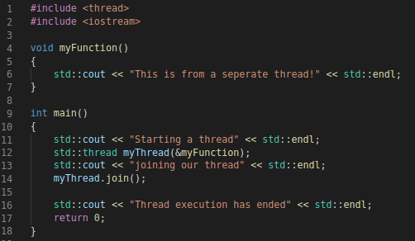

How do we thread?

Slide 5
What is going on when we thread?

Slide 6
Why would we want to thread?
Threading allows us to launch multiple chains of concurrency from one location.
This is nice to launch threads of execution we described before, allowing for events that require a wait to not pause everything in your application
More importantly for us right now, it allows us to take an algorithm we described before and run it in parallel.

Slide 7
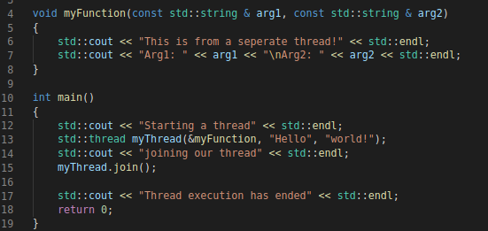

How do we thread gooder?
Arguments!
You can pass arguments into a thread by just sending arguments into the thread creation.

Slide 8
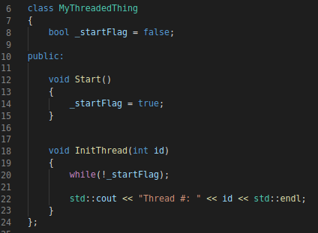
Objects and threads!
We will start by creating an object that will be designed to run within a thread
From here we can initialize N number of threads, they will wait until we call start().
Then we will join the threads.
You spawn the threads with the function pointer, the object that is calling said function, and then the arguments

Slide 9
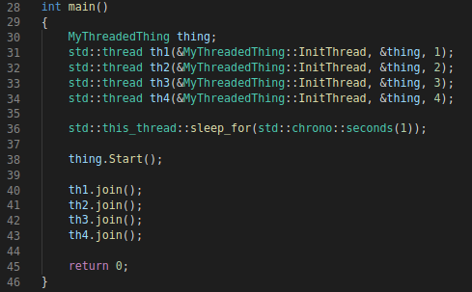



What just happened?
When you run the code to the side, you will get different answers every time. Why is this?
Threads fire off as soon as they are ready, and there is a race for the io.

Slide 10
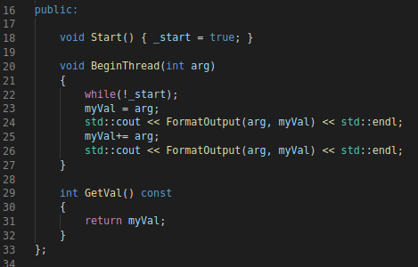

More threading pitfalls
There is one more major pitfall with threading that must be touched on, and that is memory protection.
With this, we want to just demonstrate the problem with threading, later in your career you will discuss ways to protect local memory.
Starting with this object: Pitfall

Slide 11
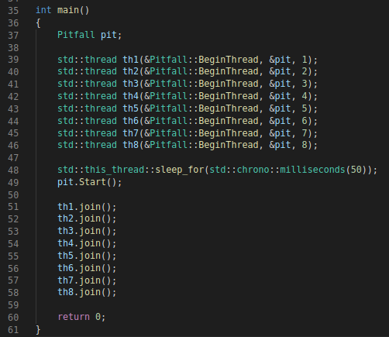


More threading pitfalls
Here is our output:
Notice that the memory overrides happen.
There are methods to help with this, but for now we will just say “don’t do it”

Slide 12
Things to remember
If you ever must handle threading, its best to avoid modifying memory that can be accessed in another thread. This will avoid the memory pitfall we discussed.
Threads take some time to initialize and be created. Remember to keep this in mind if you must use them in an implementation of an algorithm or application.
Thread execution can happen in any order. If you need threads to execute in a specific order you need to implement a blocking method.
std::thread does not provide us a way to return a value from a function. In order to do this, we must store this in a different mechanism.

Slide 13
std::future & std::async
Start with
#include <future>
From here we now have access to the two types std::async and std::future.
When compiling with this library, you must include –pthread in your compile flags
Std::async is the thread object with two options on launch, launch now (std::launch::async) or launch when we need the value (std::launch::deferred). The 2nd is called a “lazy initialization” and is used in other types of languages.
Std::future lets us store a return value from this thread that we created
https://en.cppreference.com/w/cpp/thread/async
https://en.cppreference.com/w/cpp/thread/future

Slide 14
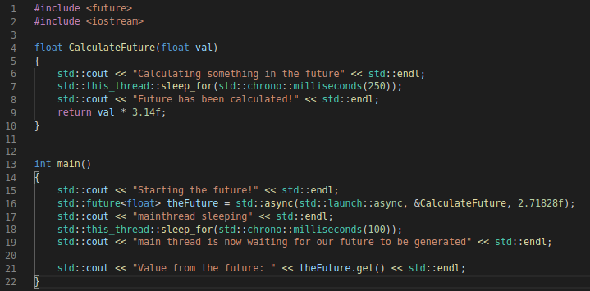
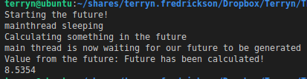
Example code

